Slide 1
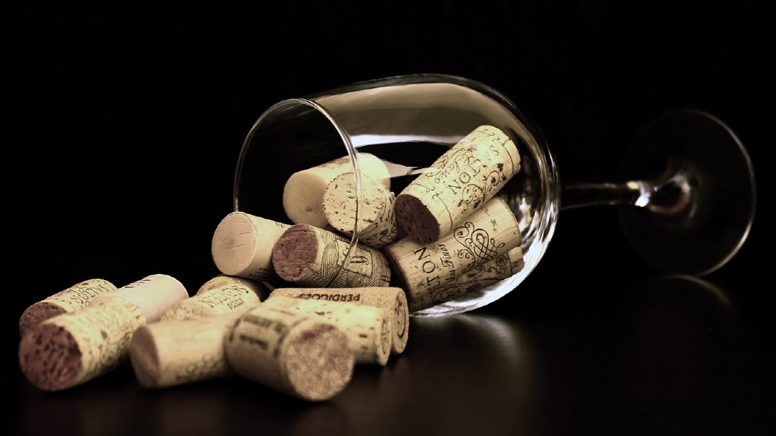

ine O’clock
Project Team 3:
Anvesh Bompally
Pushkar Dilip Dhabe
Likitha Gopi
Shubham Patidar

Slide 2
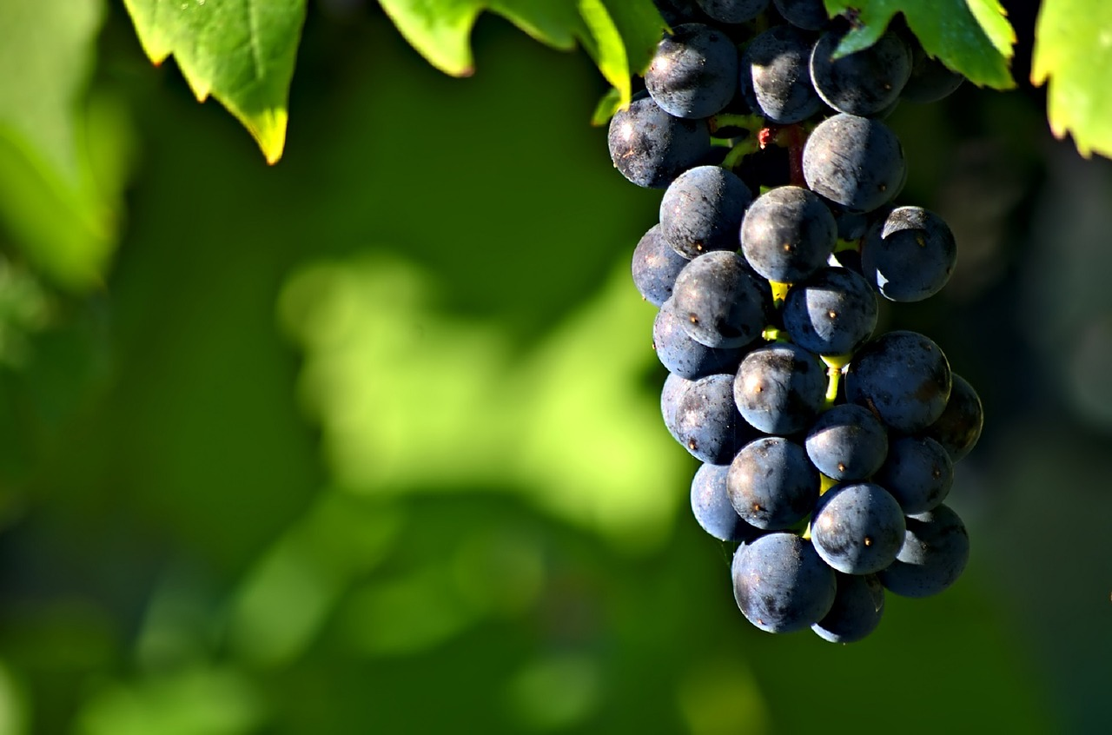
PROJECT OBJECTIVES
The main objective of this project is to create a unified enterprise-wide solution for winery management.
Wine O’clock aims to produce and sell premium varietal wines at the ‘Millennial Young adult’ consumer.

Slide 3
HIGH LEVEL DESIGN
Design
.
Architecting a relational database management system to establish consistency, synchronicity availability and security.
Development
Carefully transformed business aspects into entity relationship diagram model, Ultimately implementing it into physical database using Microsoft SQL server.

Slide 4
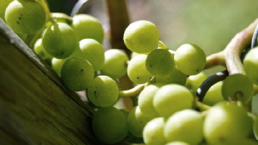
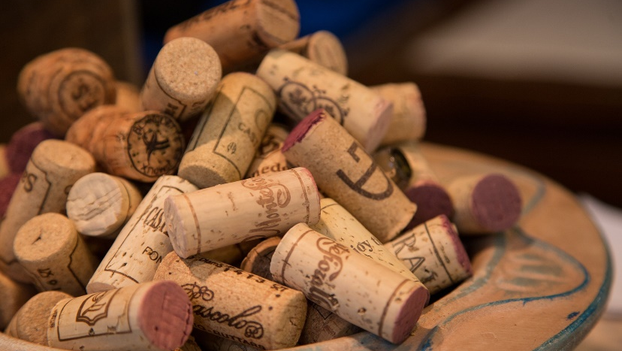

Scalability
Wine O’clock database runs on Amazon Web Services, ensuring that the database can easily be scaled out accordingly
Analytics
Modern visualization tools like Tableau have been used to provide meaningful insights into our data. This will allow us to enhance the decision making process for the business.

Slide 5

Entity-Relationship Diagram
The entity relationship diagram consists of 15 entities out of which we have 2 associative entities. With this database design, we want to make it easier for the organization to maintain data about all their customers and orders. It also allows us to keep a close track of every step of the delivery process as well. Details about the wine mart and the vineyard which is supplying the processed wine are also being maintained to make sure that the organization can always maintain the right stock level to provide a hassle-free experience to their customers.
Link – ER Diagram

Slide 6
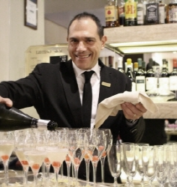

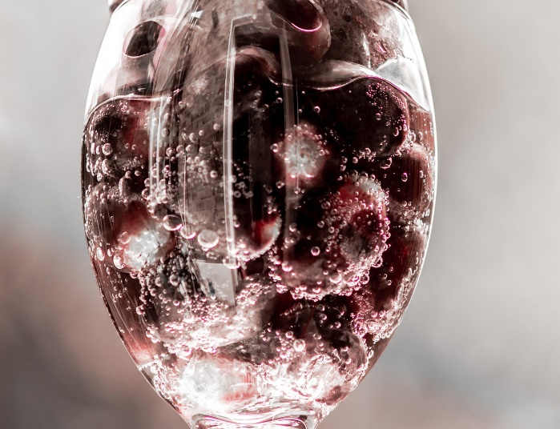


Database Objects
Following are the links to our SQL scripts
DDL
DML
STORED PROCEDURES, VIEWS, TRIGGERS etc.

Slide 7
Useful Links
The following links will help you to access the visualizations and the frontend GUI.
Front End GUI
01
Retool
Database Endpoint
02
AWS Host Name
Tableau Dash
03
Link
04
GitHub Link
Git Link

Slide 8
All members have contributed equally towards all aspects
CONTRIBUTION
GUI, AWS, VISUALIZATION(TABLEAU), DDL, DML
ER DIAGRAM, DDL, DML
Anvesh
Pushkar
DDL, DML, FINAL ER DIAGRAM
DDL, DML , DESIGN DOCUMENT
Likitha
Shubham

Slide 9
THANK YOU!!

